Slide 1
RETELLING OUR STORIES
A PHOTOVOICE PROJECT
Ana Maria De La Rosa
UUSC

Slide 2
Group Norms
RESPECT FOR SELF AND FOR OTHERS
CREATE A SAFE SPACE : RESPECTING,
LISTENING, AND SHARING WITH INTENTION
BE AN ACTIVE PARTICIPANT ASK QUESTIONS, AND EXPLORE THE ANSWERS
KEEP AN OPEN MIND AND AN OPEN HEART
ONE MIC, ONE DIVA
RESPECT CONFIDENTIALITY
SPEAK FROM YOUR OWN EXPERIENCE: USING "I" STATEMENTS
LANGUAGE CHECK
CHECK IN

Slide 3
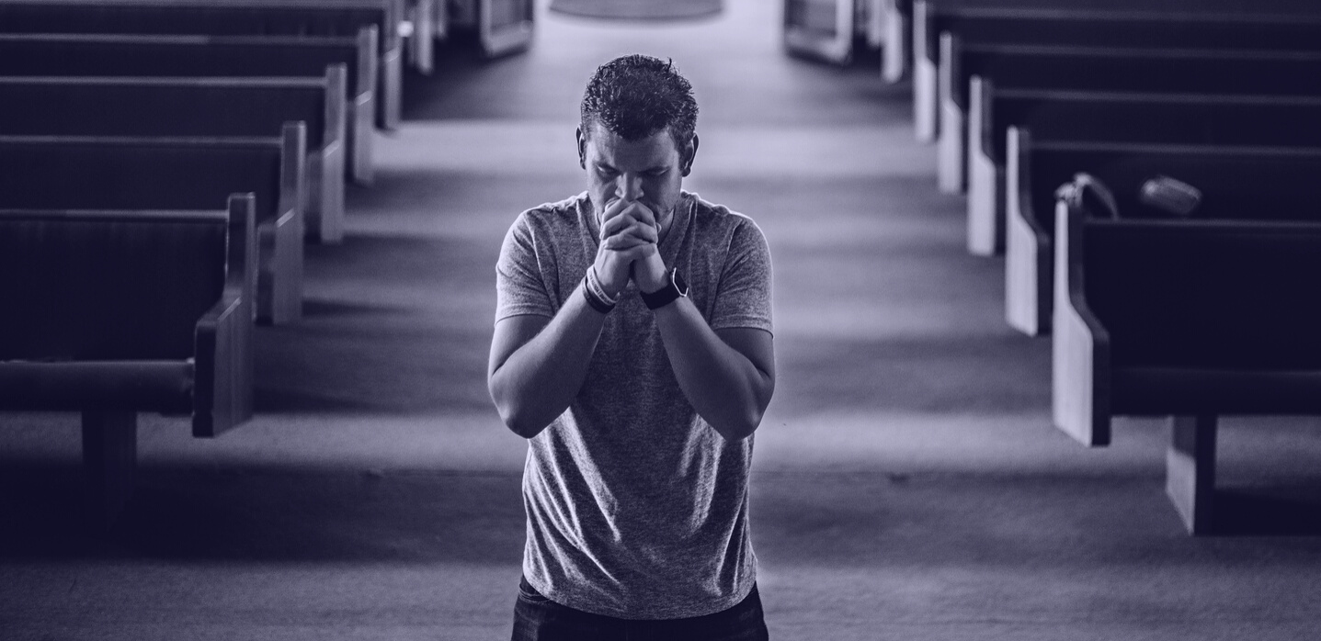
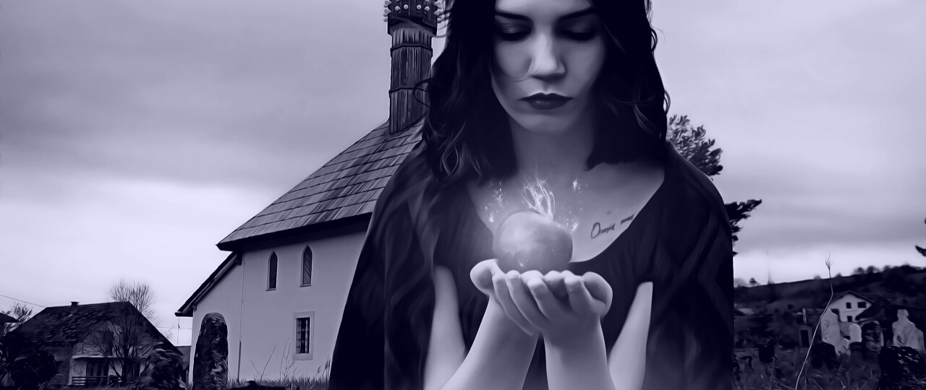
The Power of Stories
Creation Stories
Superhero Stories
Fairytales

Slide 4
“ We live in a society where telling stories allows us to…."
WRITING PROMPT

Slide 5
WE TELL STORIES EVERY DAY
Art, music, dance, oral traditions, photography, poems,
We are stories: We tell stories with our hair, clothing, our body language, scars, tattoos, the choices we make about the things we care about.
WHAT STORY ARE YOU TELLING TODAY?- WRITING PROMPT

Slide 6
Power: the ability to do something or act in a particular way; the capacity or ability to direct or influence the behavior of others or the course of events
HOME
SCHOOL
COMMUNITY
GOVERNMENT

Slide 7
HAS POWER OVER
HAS POWER TO
KINDS OF POWER
HAS POWER WITH
HAS POWER WITHIN

Slide 8
Privilege: a special right, advantage, or immunity granted or available only to a particular person or group

Slide 9
RACE
CLASS
ABILITY
FINANCIAL
EDUCATION
GENDER
GENDER IDENTITY
PASSING
RELIGIOUS
SEXUALITY
Privilege is not earned (born with, inherit)
Privilege often leads to power (your power is often a result of your privilege)
Everybody has sources of privilege, therefore everybody has sources of power

Slide 10
When have you felt powerful in your life?
When Have you felt powerless?
WRITING PROMPT

Slide 11
WHO HAS POWER IN THIS SITUATION?
WHO CAN GIVE THEM WHAT THEY WANT?
INJUSTICE
OPPORTUNITY
ASK
ACTIVITY

Slide 12
Home is more than shelter, it is community and a way of life

Slide 13
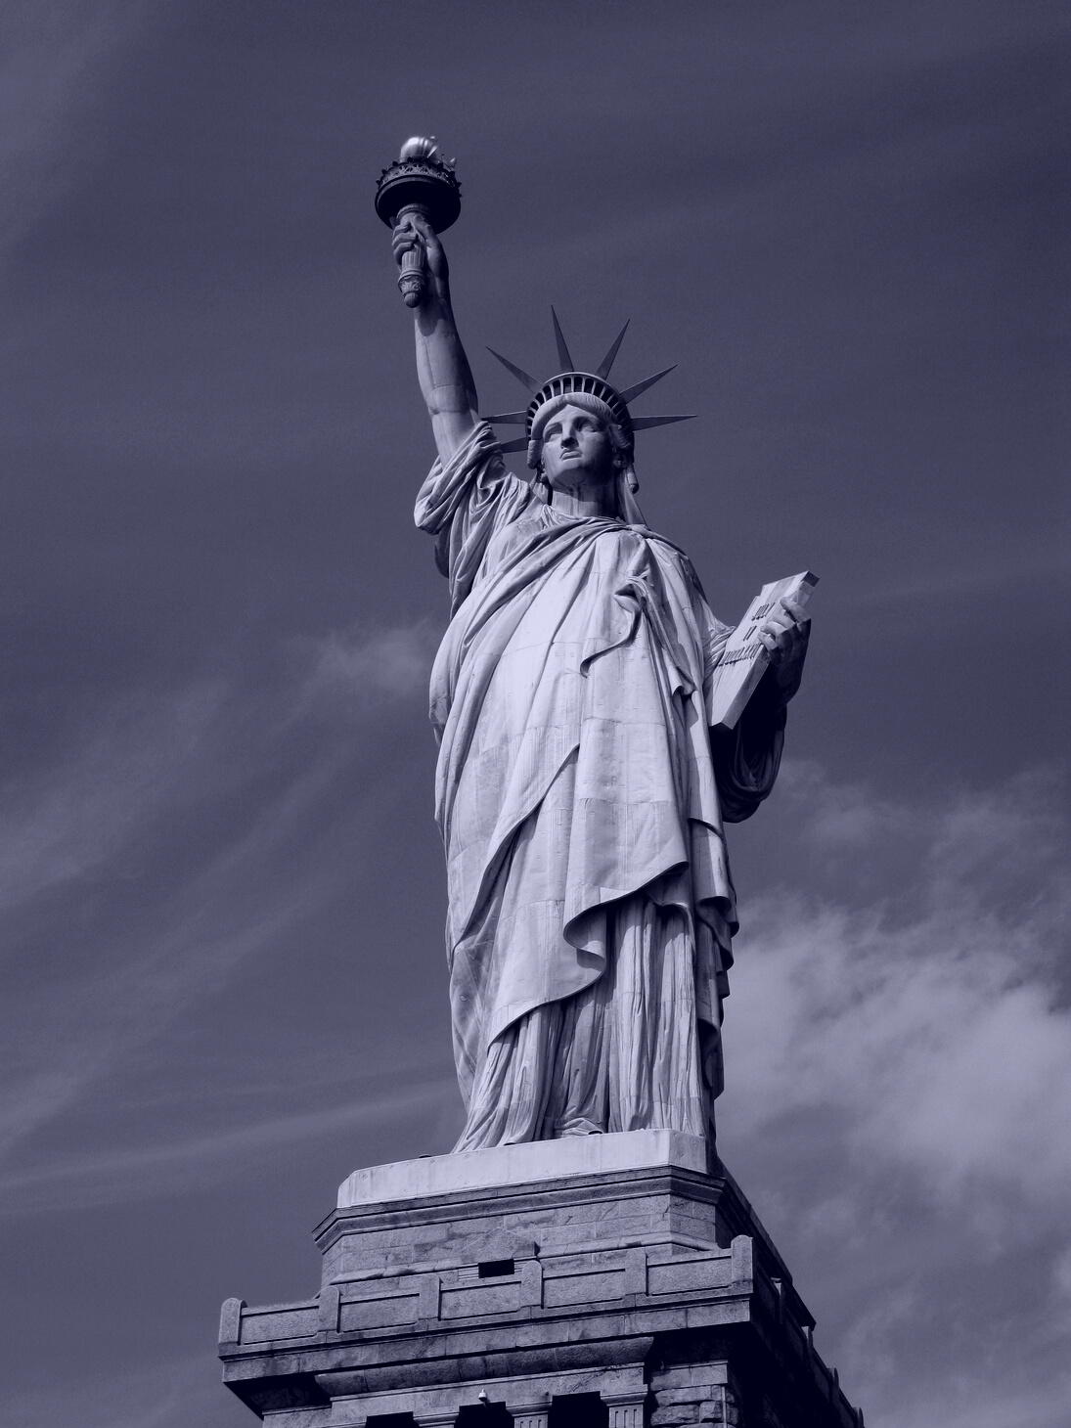
WHY DO PEOPLE LEAVE THEIR HOMES?
WHY ARE PEOPLE FORCED TO LEAVE THEIR HOMES?
DISPLACEMENT
IMMIGRATION
REFUGEES
NATURAL DISASTERS
GOVERNMENT

Slide 14
WHAT STORIES DO YOU WANT TO TELL ABOUT YOUR HOME?
WHAT DO YOU WANT PEOPLE TO KNOW ABOUT WHY YOUR HOME IS IMPORTANT?
- WRITING PROMPT
HOMELESS/ UNDERHOUSED
Families with children or unaccompanied youth who are unstably housed and likely to continue in that state...it applies to families with children or unaccompanied youth who have not had a lease or ownership interest in a housing unit in the last 60 or more days, have had two or more moves in the last 60 days, and who are likely to continue to be unstably housed

Slide 15
How can you tell your story of home through the lens of privilege and power?
How can you do that through pictures?
Create 3 goals for this project
(collective & personal)
GROUP DISCUSSION

