Slide 1
Let’s Talk About:
SOCIAL MEDIA
SOCIAL MEDIA
Notes:
Hi all, I’m Coco and I’m UUSC’s Communications Associate. A brief background about me, I’m and am from the Philippines. I used to work as a journalist and handled public relations for over two and a half years. Just a fun fact, when I was in school, a group of my friends and I created an online magazine that served as a platform for the creative youth from scratch. Ok, so I’m here to speak with you guys about social media and some best practices. But the thing is, as with anything, social media and technology is constantly changing. Lets face it, I’m now considered OLD. So I want this space to be like a workshop for all of us. My hope is that I learn from you guys and that we get to share what we know. I’d want this to be a space of learning and of sharing. My experiences are completely different from all of yours, and I’d appreciate it very much if you all could be brave and tell me if I’m saying anything wrong or that might not be applicable. I believe that this project IS yours, will really shed the much needed light on your situation and just your ability to change the narrative is incredibly powerful and promising. Shall we begin?

Slide 2
What do you have access to?
What do you have access to?
Twitter
Facebook
Instagram
Notes:
First, I want to know – what do you have access to? Twitter? Facebook? Instagram? Anything else? Who has access to – Snapchat? What about Tiktok? Would you mind sharing with me what you use your social media accounts for?

Slide 3
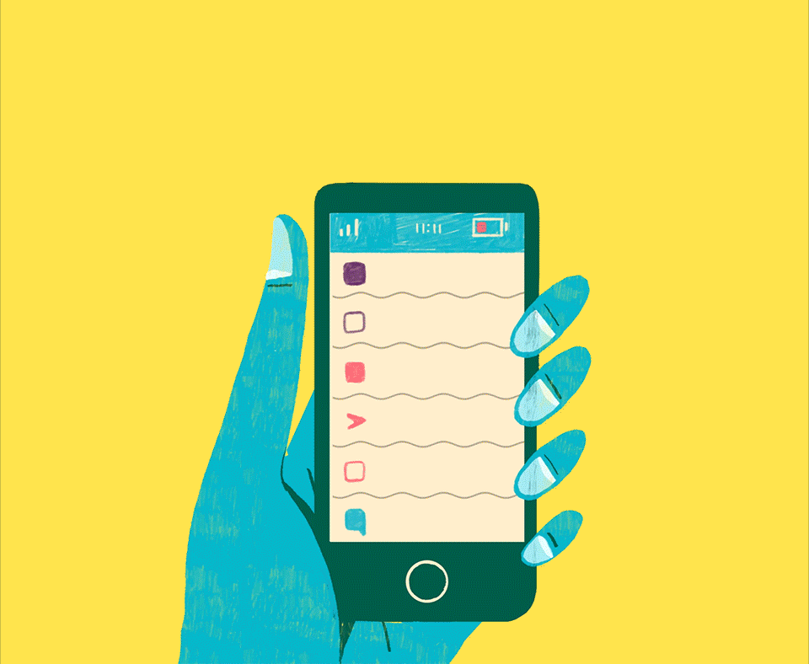
Let’s start playing
Notes:
You know how other discussions and presentations ask you to hide your phones? Well this time, I want you guys to use your phones and well, we’re just going to play. If you have your phones out and ready, I want you guys to open your social media accounts. Tell me what you guys see? Who do you guys follow? What do they post? Do you mostly follow your friends? What makes social media all fun for you?

