Slide 1
Safe2 Covid-19
Early warning system for the COVID-19 crisis.
Your
Health
Your
Privacy
Your
Community
Your
Economy
Insert Logo Here
Notes:
START RECORDING - INCLUDE SAFE2 LINK IN THE CHAT PAGE
On behalf of everyone at Safe2! Welcome to this first onboarding pilot with Catholic Charities. As our partners during this pilot!
YOU ARE AN ESSENTIAL PART OF MAKING THE SAFE2 COVID APP A PRODUCT THAT HELPS US ALL
Let me start by telling you a little about who we are! Safe2 is a non-profit organization made up disaster relief experts, privacy advocates and medical professionals.
We are are committed to building a smartphone app that can help give you peace of mind as you go about your day during this pandemic.
Think of it as making “Smarter Social Distancing” a reality.
REMEMBER
It is an early warning COVID exposure system.
It is private.
I would like to get us started today with a few words by Catholic Charities COO, Eduardo Gloria
As part of this pilot program, you will help us discover how we can give Safe2 participants daily peace of mind to make smarter choices when social distancing.

Slide 2
Agenda
[insert partner information]
Who we are
Pilot Project
How to Use the App
Questions and Feedback
Please use the chat function below
Notes:
So let me tell you what we are going to accomplish today.
We have already started by telling you a little bit about Safe2. We will spend a few minutes telling you about the Safe2 COVID-19 app and this pilot project.
THE MOST IMPORATANT THING TO REMEMBER IS THAT ALL OF YOU HAVE BEEN IDENFITIED AS EXTREMELY CAPABLE USERS OF TECHNOLOGY AND ARE THE FIRST PARTICIPANTS IN THE PILOT
SO IN ADDITION TO YOUR FEEDBACK ON THE APP...WE ALSO WANT YOUR FEEDBACK ON THIS PRESENTATION AS THE FORM WE WILL USE AS WE ROLLOUT TO ADDITIONAL STAFF.
IF YOU THINK WE HAVE TOO MUCH OR NOT ENOUGH...PLEASE LET US KNOW
We will then go through the App, highlight some of the features, and show you how to use it.
We will also show you what some of the functions will look like as the app develops with your feedback and input.
I will encourage to follow along on your device if you can.
We will also have some time to take any questions you might have. We’ll check in regularly
PLEASE USE THE CHAT FUNCTION OF THIS WEBINAR TO CAPTURE ANY QUESTIONS YOU MIGHT HAVE SO THAT WE CAN ENSURE AND GET ANSWERS BACK FOR EVERYTHING
ANY QUESTIONS BEFORE WE GET STARTED

Slide 3
Mission
Notes:
As a Pilot Community, Catholic Charities will become one of the first partners to pilot the new Safe2 COVID App.
You will have the opportunity to use the app
As a part of the Pilot team you will have the opportunity to give us feedback about how the app is working, give us your ideas for how it better help build a better app
Over the course of the next few days and weeks, your leadership will help the entire community. SO THANK YOU
Let's take a look at a quick video to help give you a sense of the Safe2 App does.
Everyone please go to safe2.org and watch the one minute video on the screen

Slide 4
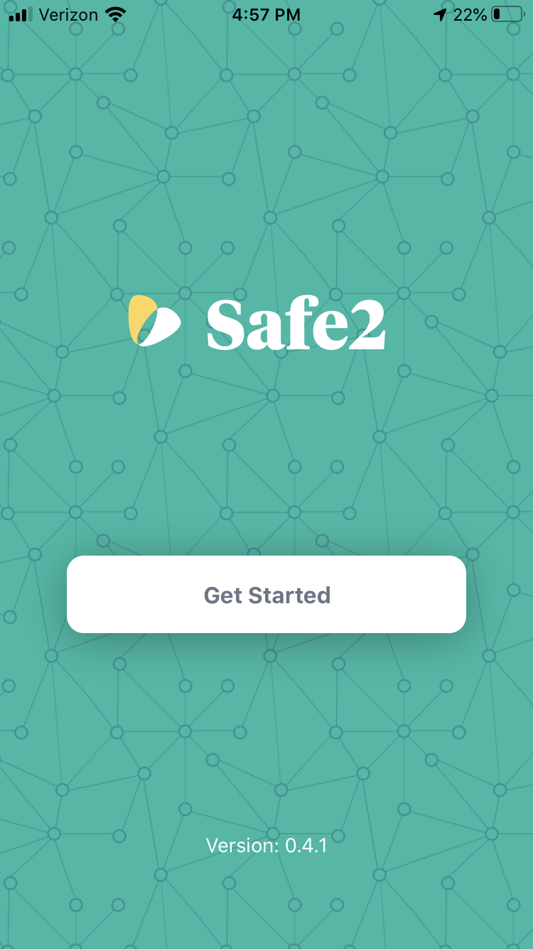
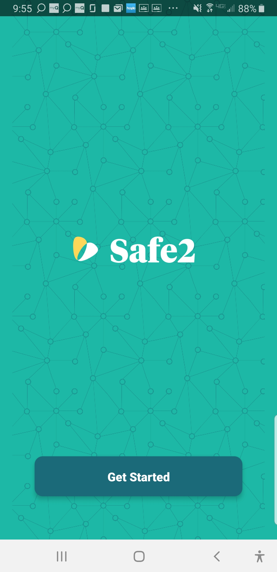
Downloading the App
Apple
Apple App Store Connect
TestFlight
Android
Download the .apk file
Blocked by Play Store
Install Anyway
Apple
Android
Notes:
Download and Installation
Each of you recieved download instructions prior to this call.
I’d like to highlight just a couple of things about the download process in case you haven’t had the opportunity to finish downloading the app.
Apple
Apple App Store Connect
TestFlight
Please note that you can manage notifications inside test flight
Android
Download the .apk file
Blocked by Play Store
Install Anyway
If you are still having a hard time downloading or installing. I’m gonna ask that you make a note in the chat function or email me at the end of this call and we can work on on one.

Slide 5
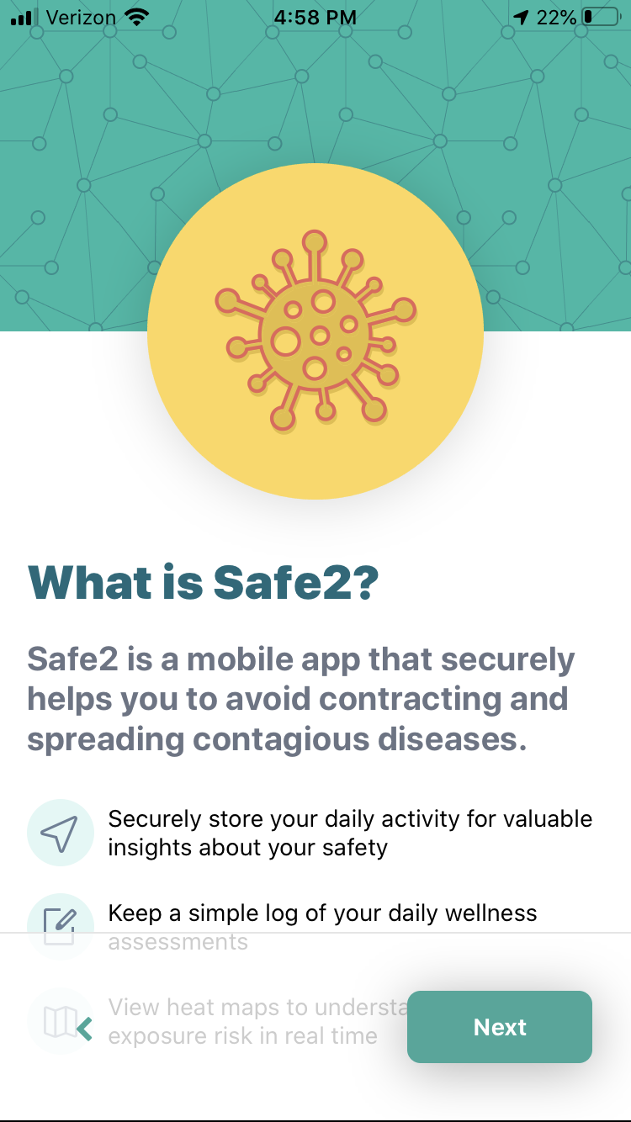
What is Safe2?
Your early warning system for COVID-19
Securely tracking daily activity
Providing location based risk alers
Asking you to complete a daily self-assessment
You get valuable insights about your safety
Notes:
Now the app is going to start informing you on what its going to do and the functions it has.
Here you can see some basic information
The Safe 2 App is your early warning system for COVID-19
It securely uses your phones GPS and Bluetooth system to alert you of any contacts or locations that might at high risk for COVID-19 exposure.
You can can check in daily in a simple wellness check that will ask you about testing or any potential symptoms you might be having
Lets all click next.

Slide 6
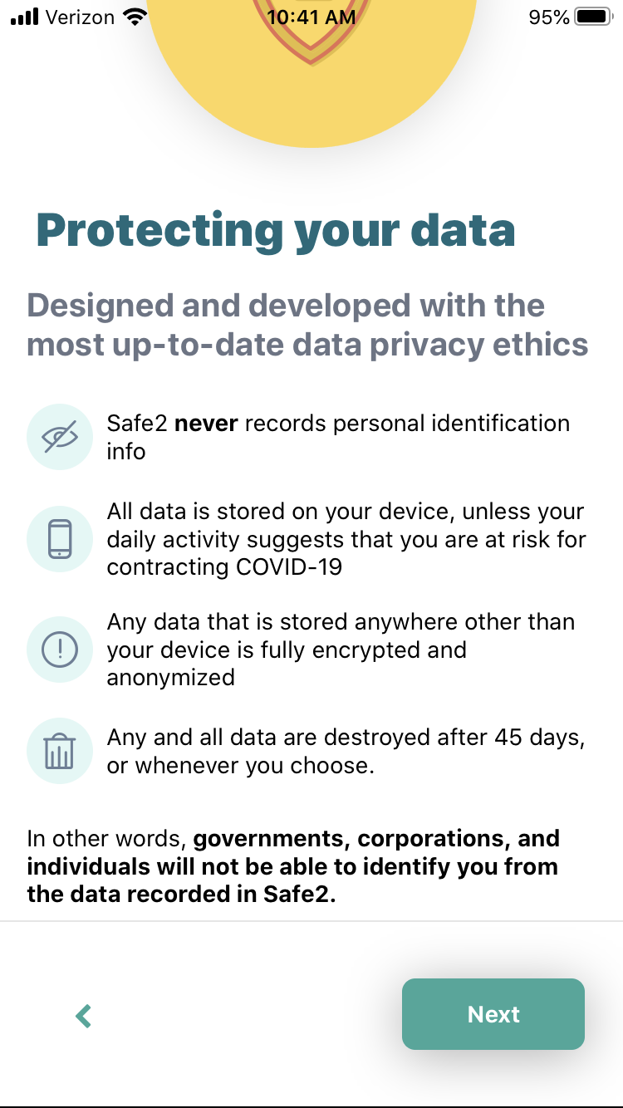
Protecting your Data
Safe2 never records personal identification information
All data is stored securely on your device, unless activity suggests you are at-risk for contracting COVID-19
If and when that data is sent to a Safe2 cloud server, the data is fully encrypted and anonymous
Any and all data is destroyed after 45 days
Notes:
The next screen shows us more info our how Safe2 protects your data
The Safe2 app never reports personal identification information
All of your data stays securely on your device with one exception. If your safe score drops too low, anonymized location data - only from likely contagious periods - is shared with your community to notify others of possible exposure.
If and when that data is sent to a Safe2 cloud server, the data is fully encrypted and anonymous
Any and all data is destroyed after 45 days (current versions may reference 60 days but that is being updated)
Your data is on your phone, anonymous and not shared with Catholic Charities, or any public or governmental agency. It does not create an ant trail of where you have been and can be deleted at any time.
Not only is there no ant trail with your name on it, there’s no ant trail at all!
KATHLEEN DO WE HAVE ANY QUESTIONS. DOES ANYONE HAVE A QUESTION AT THIS POINT

Slide 7
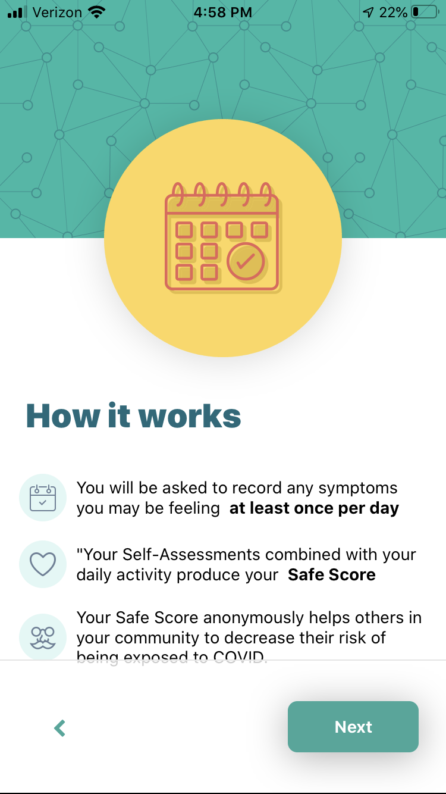
How Safe2 works
Each day will you be asked to record any symptoms you may be feeling at least once a day
These daily assessments and your daily activity will produce your Safe Score
Your Safe Score allows you to anonymously inform others in your community how to decrease their own risk
Notes:
Our next screens talk more about how the Safe2 app works
Each day will you be asked to record any symptoms you may be feeling at least once a day
These daily assessments and your daily activity will produce your Safe Score
Your Safe Score allows you to anonymously inform others in your community how to decrease their own risk.
Your Safe2 app will remember any locations you have visited for more than 2 minutes or close contacts, storing them only on your mobile phone.
If you experience a possible COVID exposure, the Safe2 app sends an anonymous copy of each location visit and contact made, only from the period you were likely contagious, along with an indication of your exposure status.
This allows other users to know when they may have been exposed as well. No data relates to any user identifier and no two data entries relate to each other.

Slide 8
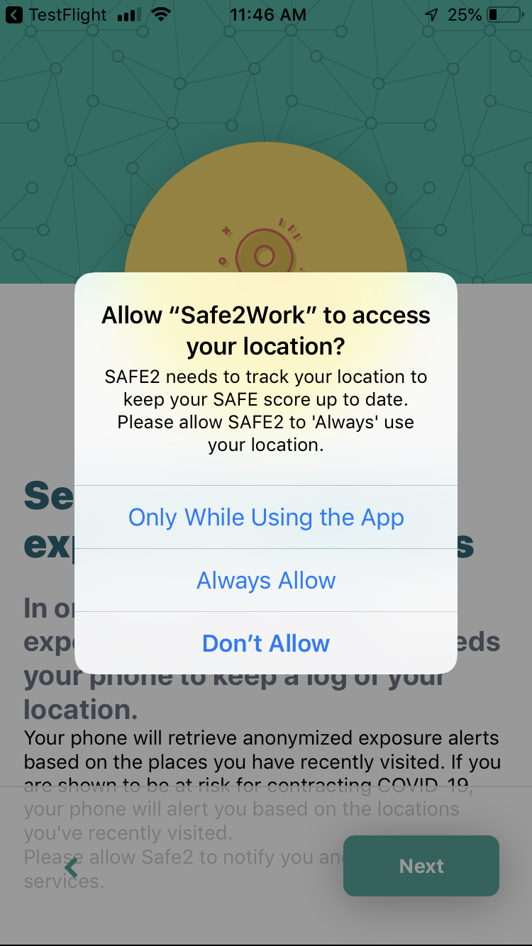
What the App needs to Help
Keep your Phone on
App access to your GPS location
Bluetooth should be switched on
Choose “Always Allow” when asked for location access
Notes:
There are just a few things that the app needs from us to help our community!
Keep your Phone on
Give the app access to your GPS location
Keep your bluetooth switch on
Choose “Always Allow” on the following screen
Thats it!

Slide 9
Let’s Get Started!
Safe2 never records personal identification information
All data is stored securely on your device, unless activity suggest you are at-risk for contracting COVID-19
You own the data and in the settings of the app, you can delete your data at any time.
Agree to the Terms of Service and Privacy Policy and Click Let’s Go!
Notes:
So thats the overview and its time to get started!
To get started we’re going to have you agree to the terms of service and privacy policy (still needs linked) on the lets go page
Remember we are in the pilot
And click lets GO
KATHLEEN DO WE HAVE ANY QUESTIONS. DOES ANYONE HAVE A QUESTION AT THIS POINT

Slide 10
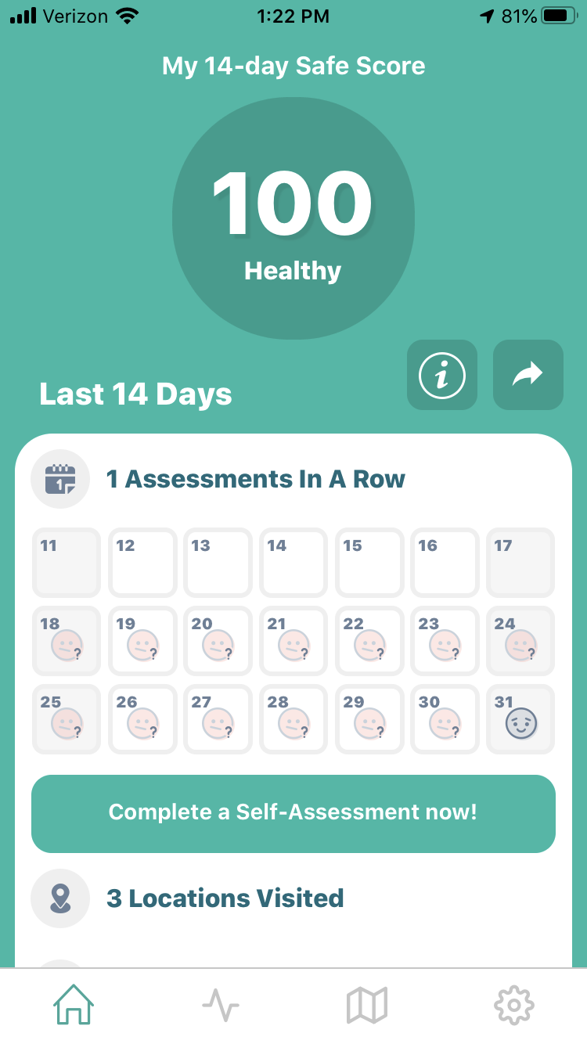
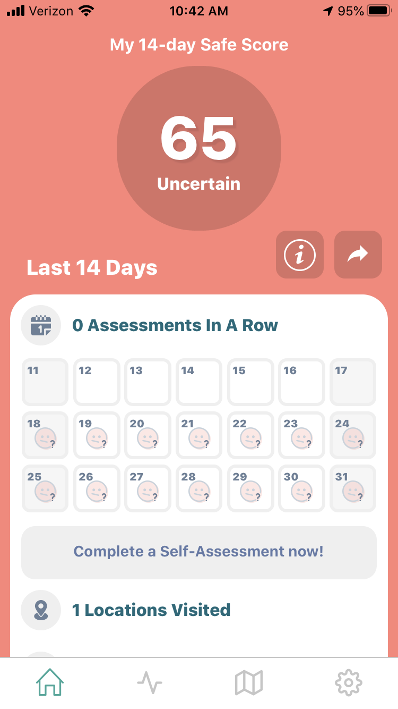
Navigating Safe2
Home Page
Safe Score
Locations
Contacts
Self-Assessments
Home Button
Notes:
IF you not already, please click the home screen button (it looks like a little house).
Navigating the app itself is just as easy - Tab one is the Home screen
Here you can see the home screen and right at the top you have
Your SAFE SCORE - based on ….
Information on the last two weeks of activities including locations, contacts and your self-assessments last 14 days
I also want to point out two additional buttons on this page
First is an info button (i in a box) - this will take you to an explanation of your safe score (we’ll look at that in the next slide)
Right next to that button is a small downloard box (looks like a open box with an arrow) - the intent with this box here is to give each of use the opportunity to share (if you choose to) your safe score with others. This functionality will be available soon.

Slide 11
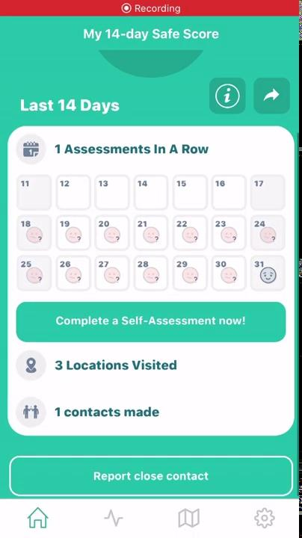
Are you ready for your first Self-Assessment?
Two Questions
Do you have symptoms?
Please check all symptoms
that apply
Notes:
Now lets a spend a few minutes and all do our first Self-Assessment together.
The list of symptoms we use are straight from the CDC guidance
A you can see there are just a few basic questions and THATS IT! Easy!
Android - list
Apple
FEEDBACK CHANCE - those of you on apple you will see two screens.
The first asks if you are having symptoms YES or NO
The second page shows you a list of symptoms
DO YOU FEEL LIKE ASKING YOU ABOUT SYMPTOMS FIRST DISCOURAGES YOU FROM LISTING POTENTIAL SYMPTOMS. Would you rather have a list of symptoms with the last choice being I HAVE NO SYMPTOMS

Slide 12
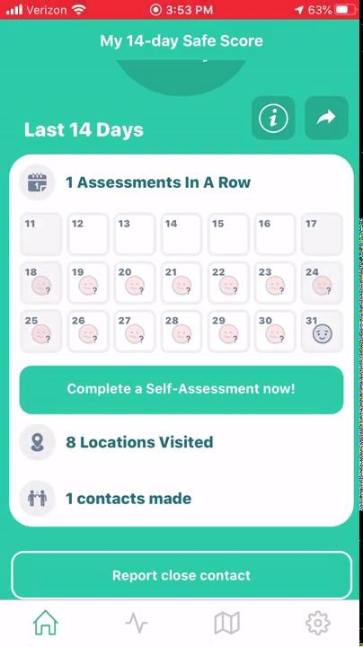
Reporting a Close Contact
Choose Report Close Contact on the Home Screen
Choose the date of exposure
Choose the duration of exposure
Notes:
One of the most direct additions we have made from user feedback has been the function to report a close contact.
This is for the possibility that we come into contact with someone that we know tested positive for COVID, but doesn’t have the app. This allows us to report the contact and update our Safe Score - HOW????

Slide 13
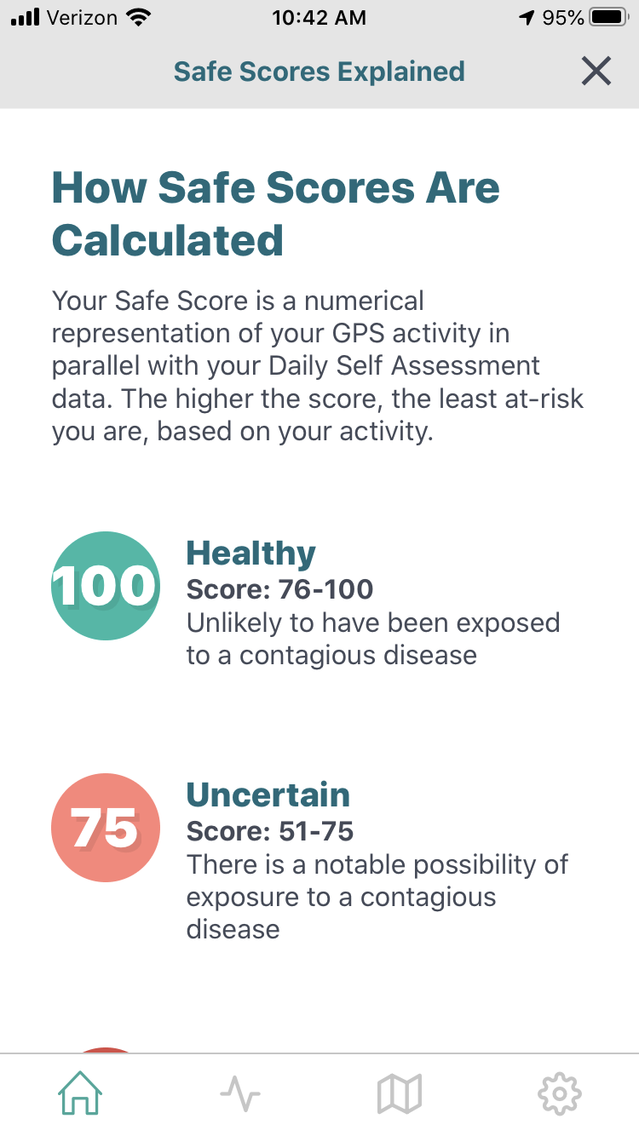
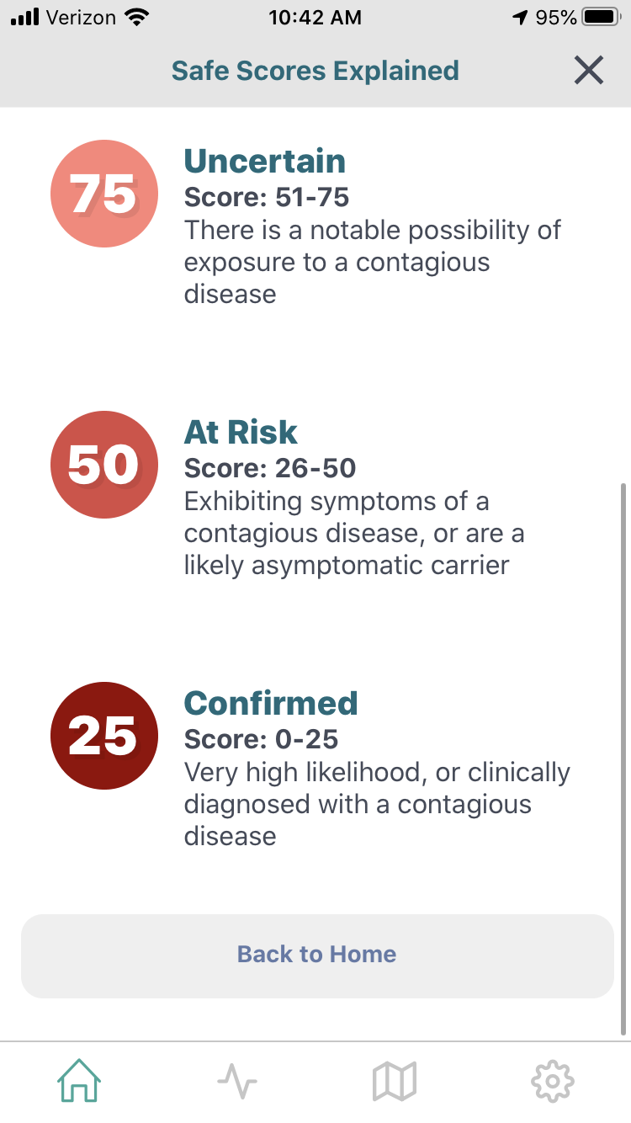
How Safe Scores Are Calculated
Notes:
After you Self-Assessment is completed, you will be given a safe score. So how is your Safe Score calculated
Your safe score is a numerical representation of your GPS activity in parallel with your Daily Self Assessment dat and symptoms
The higher your score, the less at-risk you are, based on your activity.
KATHLEEN DO WE HAVE ANY QUESTIONS. DOES ANYONE HAVE A QUESTION AT THIS POINT

Slide 14
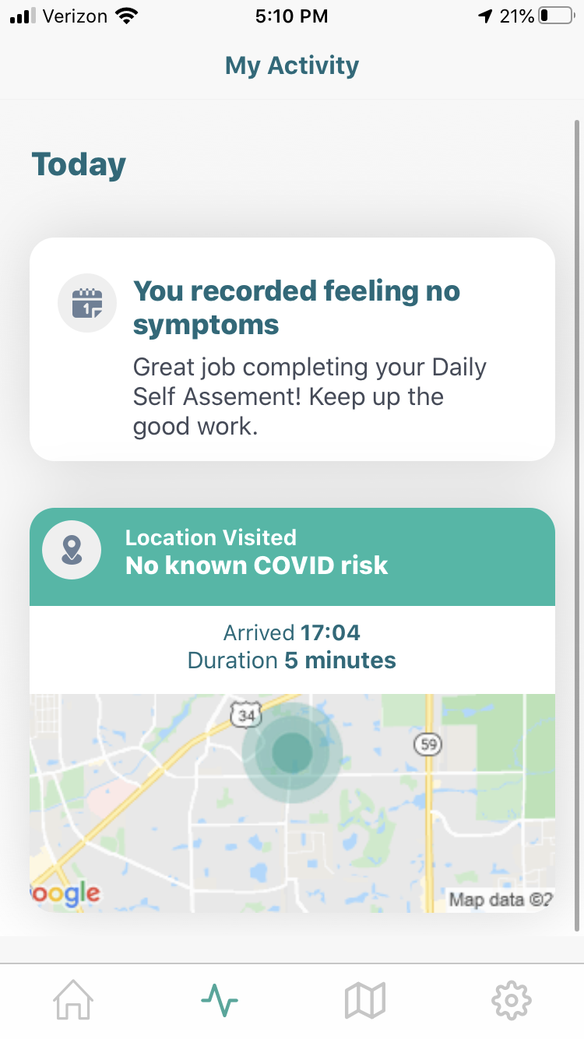
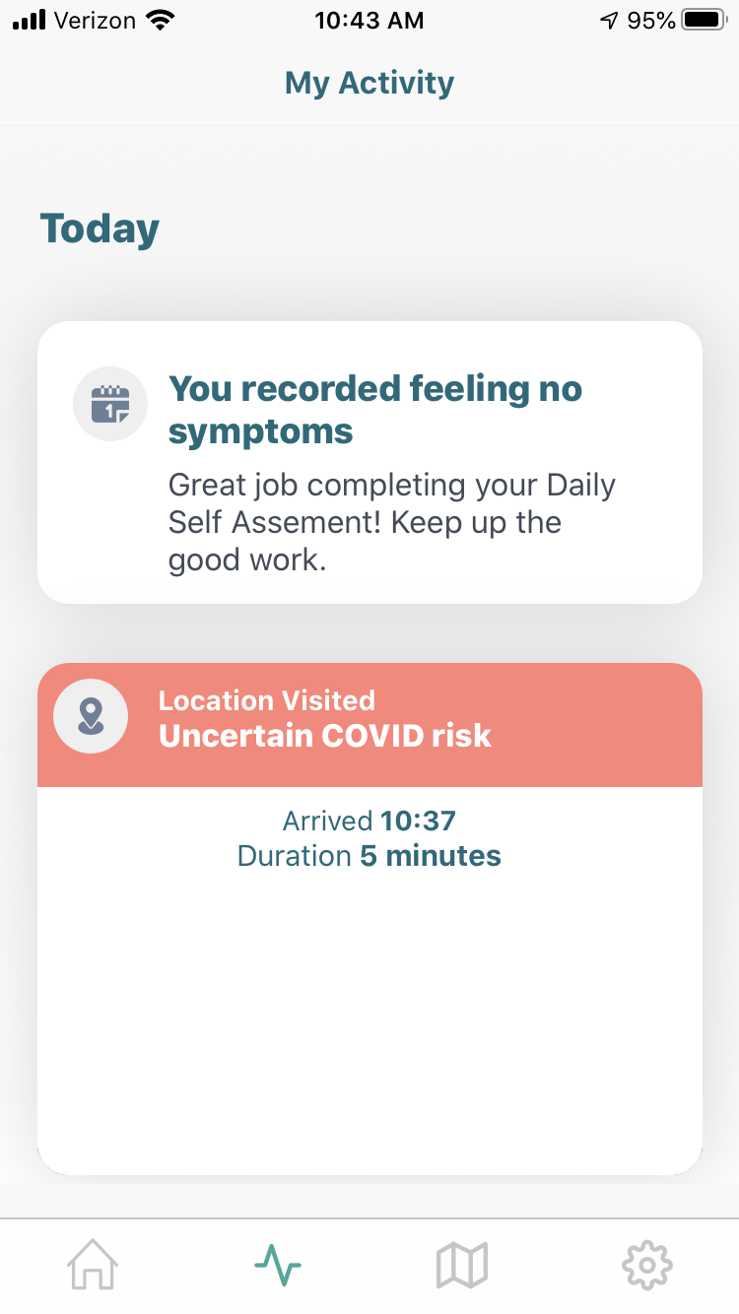
Reviewing your activity
My Activity
Self-assessment results
Locations information and alerts
Contact information and alerts
Notes:
Tab 2 is an overview of your activity including any self-assessment info and information about places you visited or contacts that were made.
I’ve included 2 screenshots here...the first is a screenshot without any activity and the second one is what the activity tab will look like when there is information entered on symptoms and or on location and contacts.
Remember your feedback will have a direct impact on how this will look

Slide 15
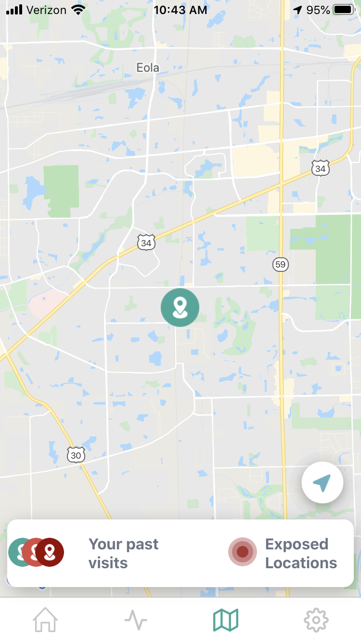
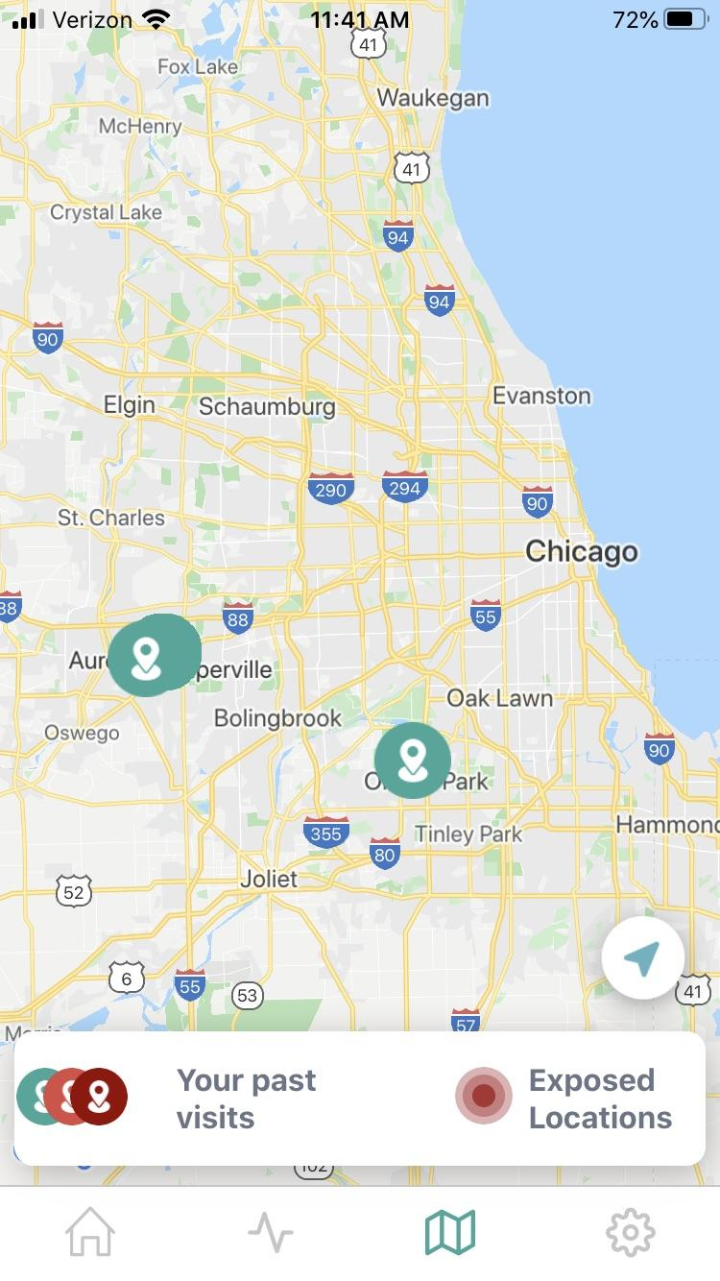
Looking around you
Safe2’s map function
Shows past visits
Shows areas of increased risk and exposed locations
Anonymous data based on data from you and members of your community
Gives you realtime information for daily decision making
Notes:
The third tab is Safe2’s heat map function….
Safe2’s heat map function will give you the ability to check out the locations around you or places you would like to go. Information on the map will show you areas that have higher risks of COVID exposure based on the anonymous data from others in your community.
This can help you make decisions in realtime.

Slide 16
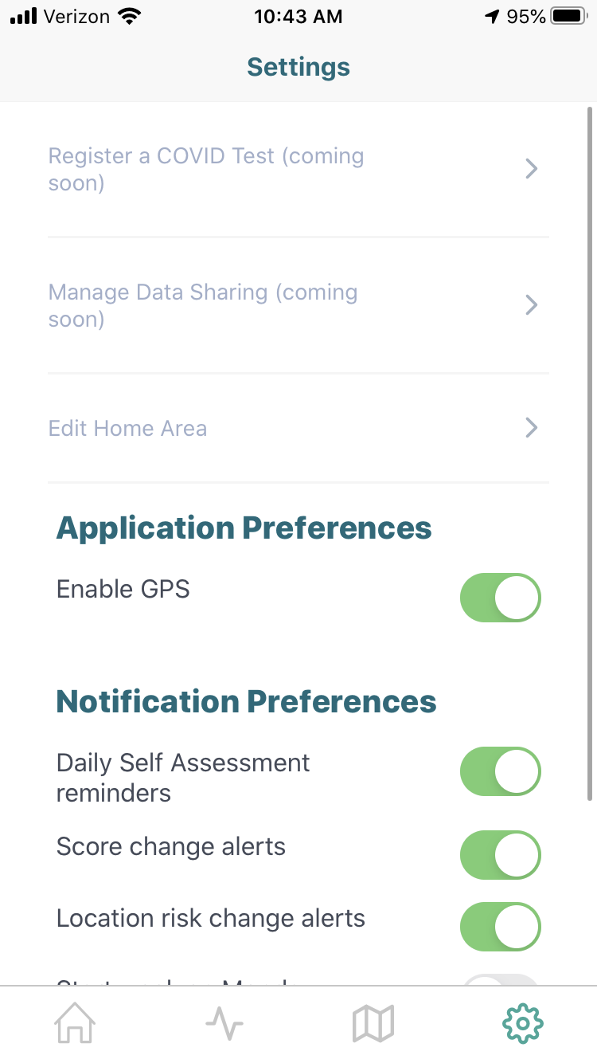
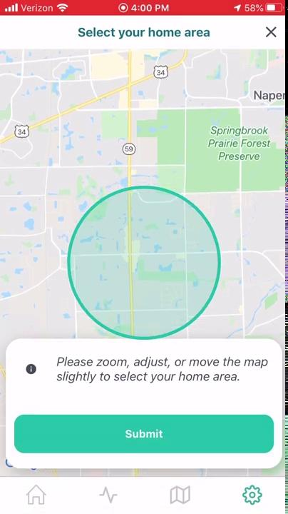
Settings you can change
Notifications Preferences
Reminders for Daily Self-Assessments
Alerts when you Safe Score changes
Alerts for any location risk changes
Future Updates will include data management and registering your own COVID test
Editing your Home Area
Notes:
Notifications Preferences
Reminders for Daily Self-Assessments
Alerts when you Safe Score changes
Alerts for any location risk changes
Future Updates will include data management and registering your own COVID test
Editing your Home Area - to ensure that you are gettin multiple alerts becuase you are at home most of the time.

Slide 17
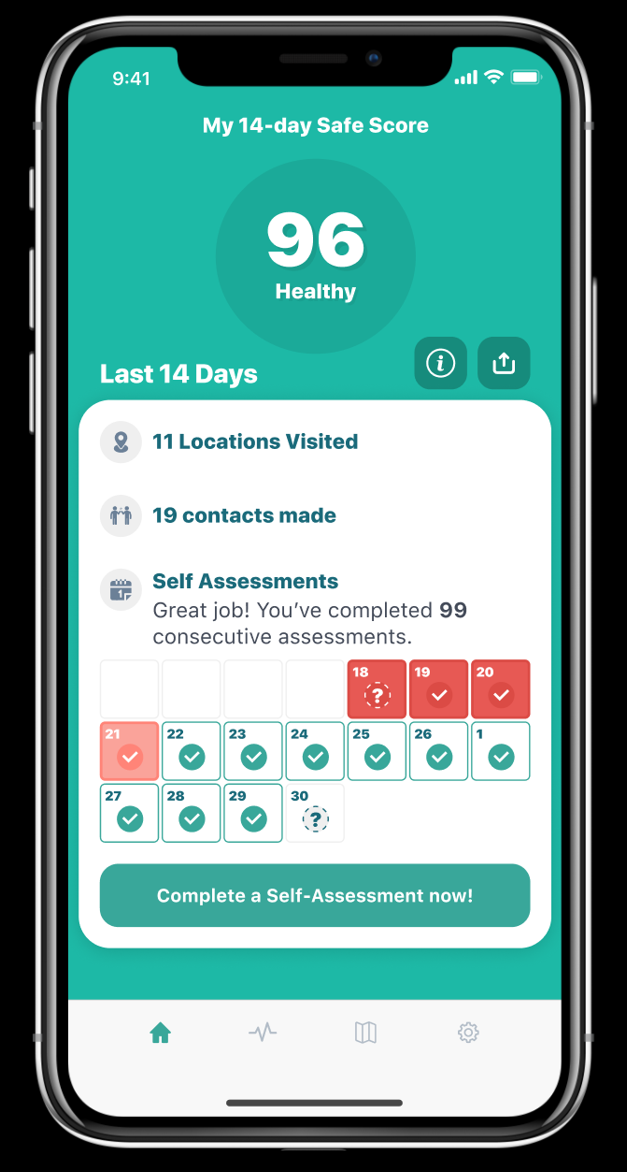
Next Steps and Resources for support
Feedback Surveys
Send Direct Feedback/Screenshots
Harley Jones, (312) 450-0179
harley.jones@safe2.org
Notes:
So thats it! First i want to thank each and every one for allowing Safe2 to work with you on helping keep you, your families and community safe.
You will have a number of opportunities to provide feedback during the pilot.
After 3 days of use and again after a week, we will be send you a survey for feedback.
I have also included my contact information here so that you can send any feedback you have directly to me.
As the first 5 users this is very important, especially as we work to rollout the app to your colleagues in the coming days and weeks.
Feedback on the app itself
Info on any bugs that you encouter
Ideas you might to make it better
Feedback on this presentation before we roll it out to the large Catholic Charities Staff
I’d like to thank you all again for your Leadership in this difficult time!
Your flexibility, patience and determination during this pilot will help us all!
Your engagement and feedback will us make the best product we can to help us all through this difficult time.
END THE PRESENTATION HERE BACK TO CAMERA
I'm going to stop there. Does anyone have any questions?
Before we end, Eduardo is there any final words you like to leave us with?

